Slide 1
Keeping Aggregates
Consistent While
Using Kafka
22/08/2019

Slide 2
Quick intro to
DDD Aggregate

Slide 3
Aggregate - is a DDD pattern
Aggregate is a cluster of domain objects that can be treated as a single unit.
An example may be an order and its line-items, these will be separate objects, but it's useful to treat the order (together with its line items) as a single aggregate.
(C)Martin Fowler
Transactions should not cross aggregate boundaries.

Slide 4
Entities and Value Objects
Entity: Objects that have a distinct identity that runs through time and different representations.
E.g. Booking, Auction/Offer
Value Object: Objects that matter only as the combination of their attributes. Two value objects with the same values for all their attributes are considered equal.
E.g. Date, Money, Pickup/DropOff points
(C)Martin Fowler

Slide 5
Aggregate = Entities + Value objects
Aggregate consist of at least one Entity, called Root Entity,
and optional Value Objects

Slide 6
Events and
topics

Slide 7
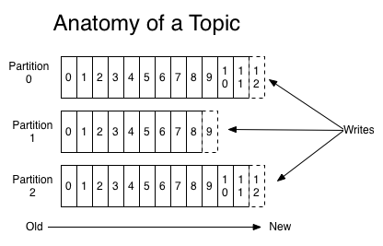
Kafka topic partitioning

Slide 8
How we manage events and topics
Any events that need to stay in a fixed order must go in the same topic
Even though there may be many different event types, all of the events that define an aggregate must go in the same topic
Format: JSON, without a statically defined schema => different event types in the same topic

Slide 9
Bookings Aggregate
Streaming to the bookings topic:
BookingIsCreated PassengerIsAdded PassengerIsUpdated BookingIsUpdated BookingIsCanceled
BookingIsStarted BookingIsFinished
Booking: Car class, Pickup & Dropoff address and time, Duration, Flight#, etc
Passenger: First & Last name, email, phone, etc.

Slide 10
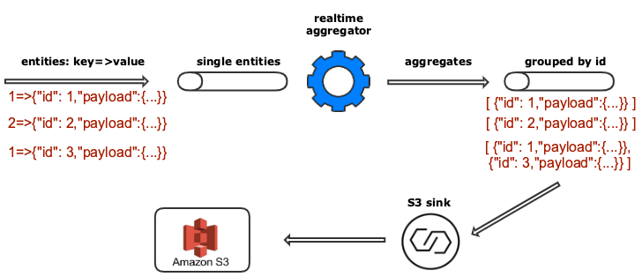
Aggregation Schema
Takes JSON events and coalesce them into an ordered JSON array for further processing

Slide 11
Few more details
https://github.com/blacklane/event-coalescer/tree/add-connect-s3
Create S3 bucket
Make sure the S3 connector has write access to the S3 bucket set in s3.bucket.name and can deploy credentials
name=s3-sink
connector.class=io.confluent.connect.s3.S3SinkConnector
tasks.max=1
topics=events-generic-21-by-id
s3.region=eu-central-1
s3.bucket.name=events-coalescer-bucket
s3.part.size=5242880
flush.size=3

